Slide 1
Youtube Advertisements
Marwa Hisham - 900172284
Mina Ashraf - 900182973
Mohammed Abuelwafa - 900172603
Sherif Gabr - 900183120

Slide 2
01
04
Table Of Contents
02
05
03
Problem Statement
Predictive analytics
Descriptive Analytics
Optimization
Feature engineering

Slide 3
01
Problem Statement

Slide 4

Problem Statement
Youtube generated 19.8 billion dollars of revenue in 2020.
The business model of Youtube is heavily dependable upon ads.
we aim to make use of the views prediction to build a data-driven optimization problem that tackles ads allocation based on the number of views that a video is predicted to generate based on its features. In this manner, we can maximize the profit generated by ads that are displayed on trendy videos.

Slide 5
02
Descriptive Analytics

Slide 6
EDA & Data Cleaning
The dataset includes trending the videos on Youtube in USA from August 2020 to December 2021. For every video, it has all its related info (title, tags, description, publish date, etc) and it contains an observation for every day it was trending on along with the views and likes and comments counts on that day.
9 categorical columns:
'video_id', 'title', 'channelId', 'channelTitle', 'tags', 'thumbnail_link', 'comments_disabled', 'ratings_disabled', 'description'
7 numerical columns:
'publishedAt', 'categoryId', 'trending_date', 'view_count', 'likes', 'dislikes', 'comment_count'
Initial Data shape
100,191 observations
16 features
17,934 unique videos

Slide 7
Missing Values
Column 'description' has 1831 Null values with percentage = 1.83 % of the whole dataset. It means no descriptions for the video, and replaced by empty strings.
Column 'likes/dislikes' has 683 Null values , percentage = 0.68 %, and these were dropped.
Duplicates
Dropped 83 duplicated rows
We have videos with multiple rows in the same trending day -> chose the most recent and dropped the remaining for the same day.

Slide 8
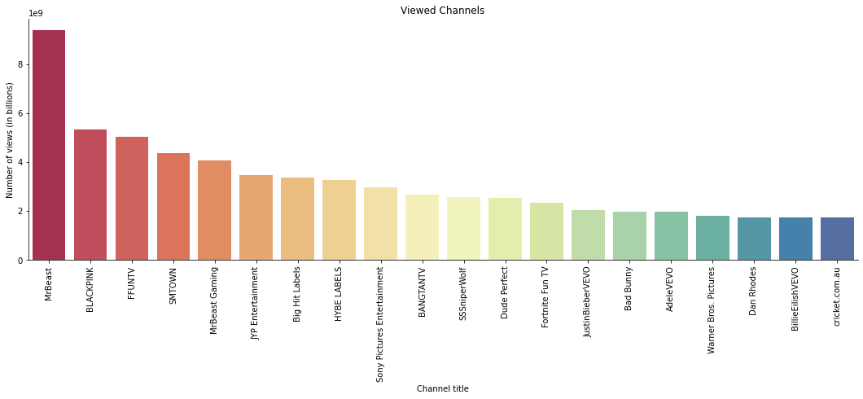
Youtube Channels Analysis
Top 10 viewed Youtube Channels

Slide 9
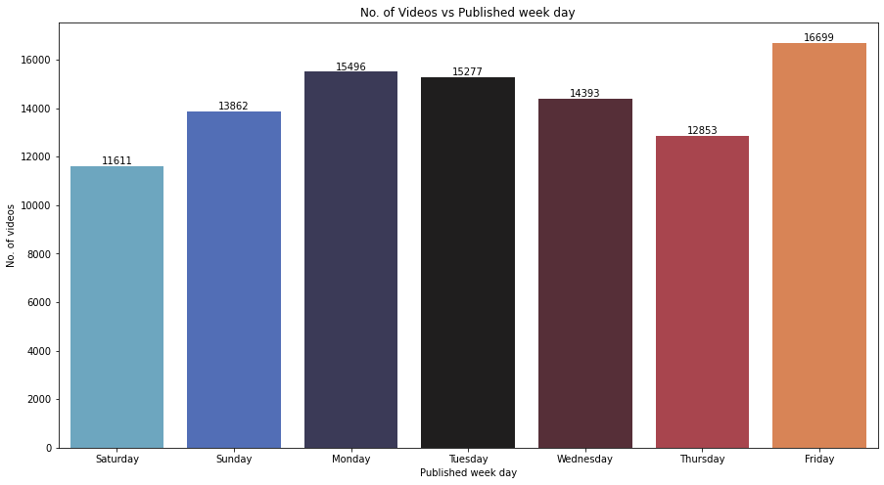
Calendar Analysis
Published WeekDay

Slide 10
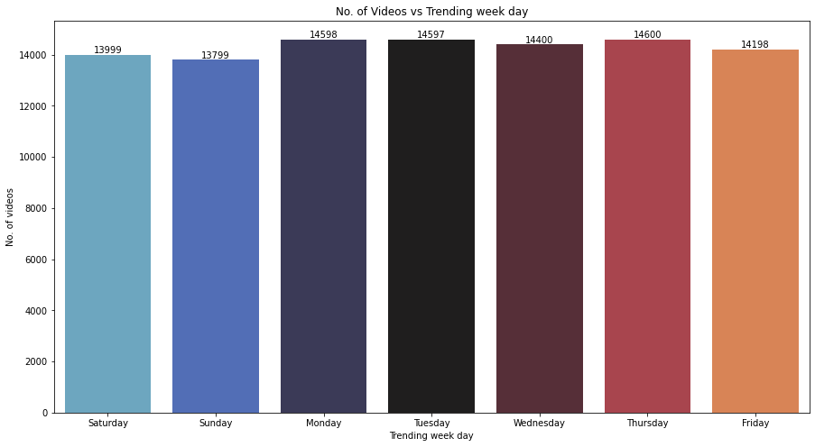
Calendar Analysis
Trending
WeekDay

Slide 11
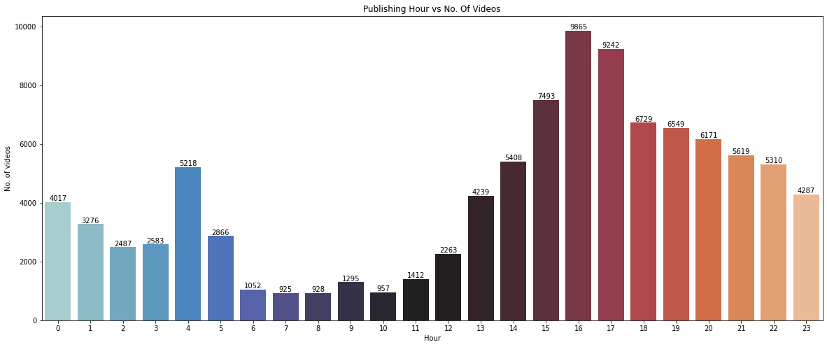
Calendar Analysis
Publishing Hour

Slide 12
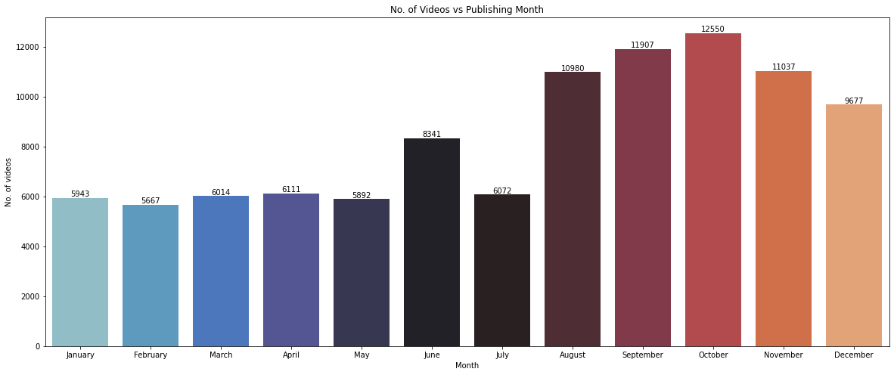
Calendar Analysis
Publishing Month
It is important to note that the months from Aug-Dec were repeated twice in the dataset since the data is from Aug 2020-Dec 2021.

Slide 13
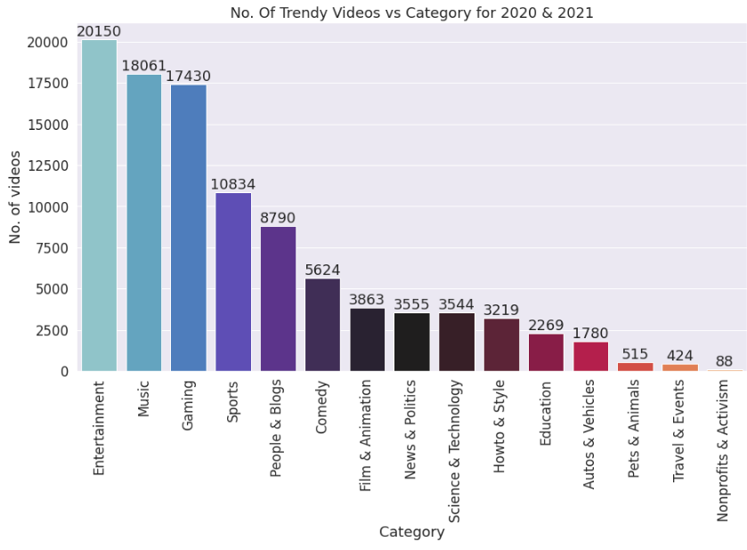
Category Analysis
some categories are more trendy

Slide 14
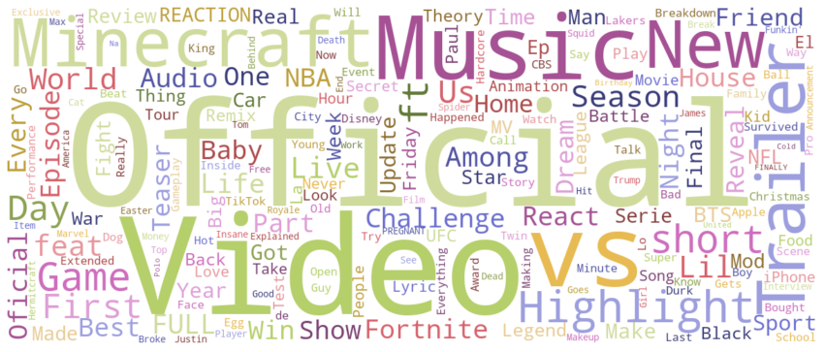
Title Analysis
The Most Common words in videos titles

Slide 15
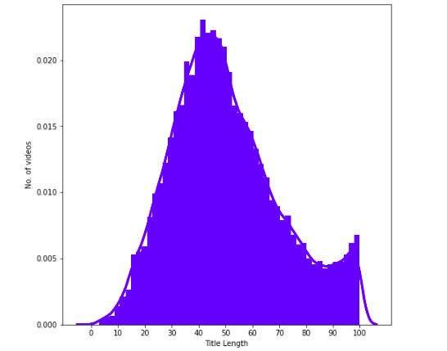
Title Analysis
Try not to make your title too short, or too long

Slide 16
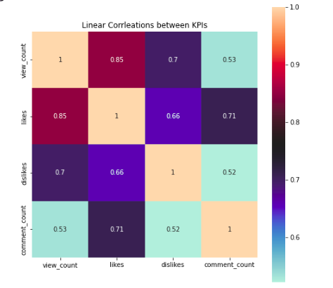
Likes and dislikes are very correlated with the views
Can we predict views from likes?🤔

Slide 17
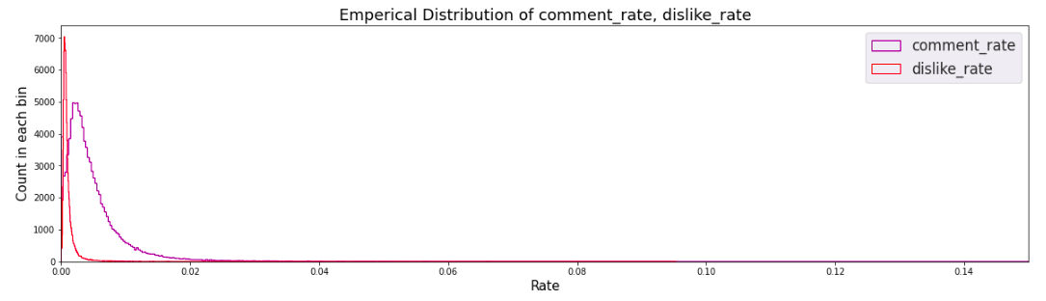
SO MANY VIEWS, yet very low number of active viewers 😔

Slide 18
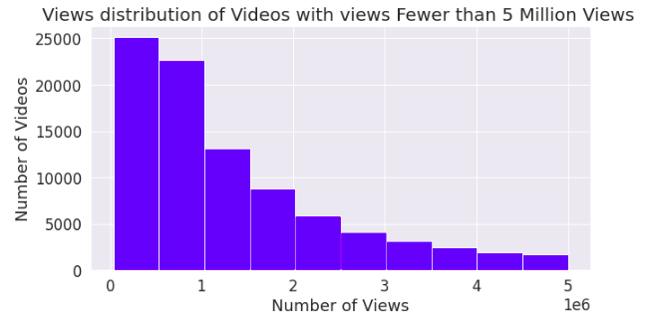
It gets harder and harder to be one of the top creators.
Few videos account for the majority of the views in the dataset

Slide 19
03
Feature Engineering

Slide 20
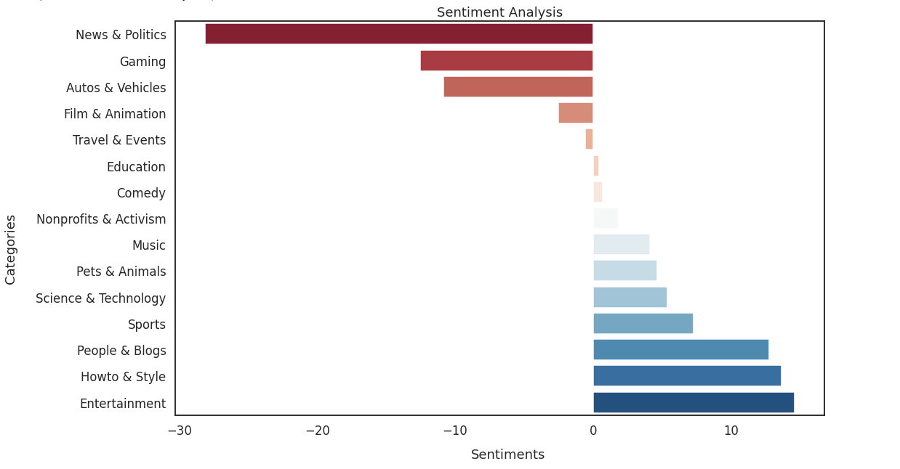
Sentiment Analysis
Since we have text features, we get their sentiment score to use them as input features.
From NLTK library Vader model, we use SentimentIntensityAnalyzer().polarity_scores()
Total Sentiment score for tags every category
> 0 means more positive
< 0 means more negative

Slide 21
Get Sentiment score for every title, description, and tags
Method 1
Method 2
Clean text from punctuation, digits, stopwords.
Tokenize
Get polarity score for every word using
the sentiment analyzer from NLTK
Add words scores
Apply the sentiment analyzer on the whole text directly
Get the compound, positive, neutral, and negative scores
The compound score ranges from -1 to 1.
(closer to 1 means more positive , and vice versa)
We now have 3 new columns : title score , description score, and tags score. They can be used as input features.

Slide 22
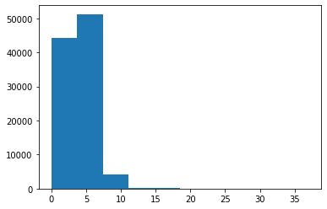
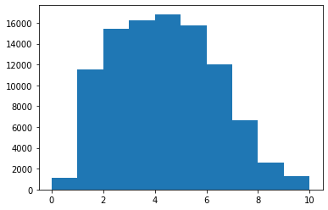
Other feature manipulation & new features
Converting ‘trending_date’ & ‘PublishedAt’ to datetime objects and separated them to 6 features: day, month, and year of each, the trending and publish date.
New boolean features ‘isPublishedWeekend’ and ‘isTrendingWeekend’
New ‘time_diff’ feature : difference between the first trending date and publishing date
the majority of the videos were trending between 0 and 10 days of their publish date. The maximum was 37 days.
Time_dff (days)
Time_dff (days)
After removing time_diff Outliers
(the mean decreased by 2 hours)

Slide 23
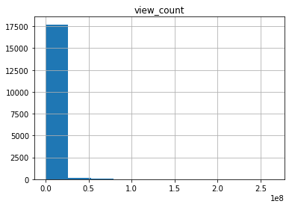
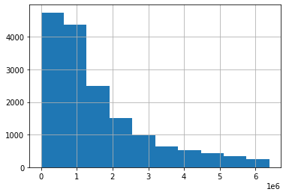
Maximum view count per video outliers:
Views count
Views count after removing outliers
New ‘Comment_rate’ feature : comment count / view count
New ‘dislike_rate’ feature : dislikes count / view count
One-Hot encoding on video category: new feature per category

Slide 24
04
Predictive Analytics

Slide 25
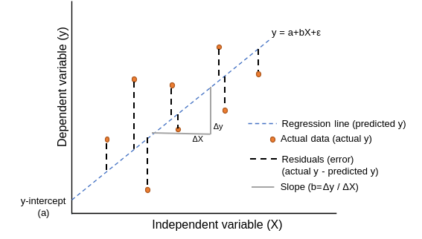
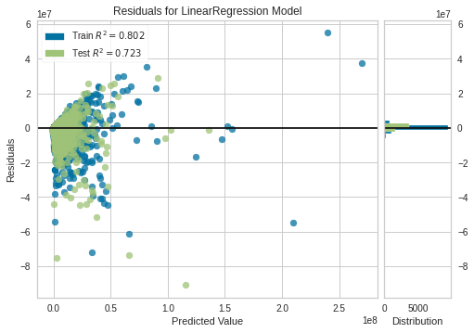
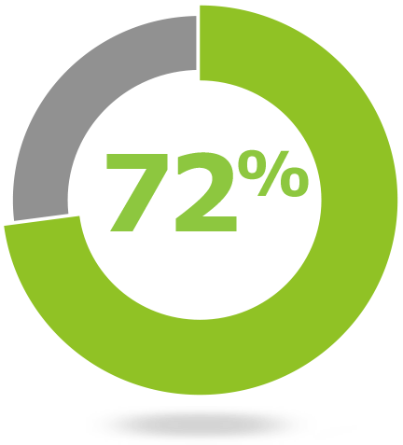
Model 1
Linear Regression
No pattern in residual plot → Linear data
👻

Slide 26
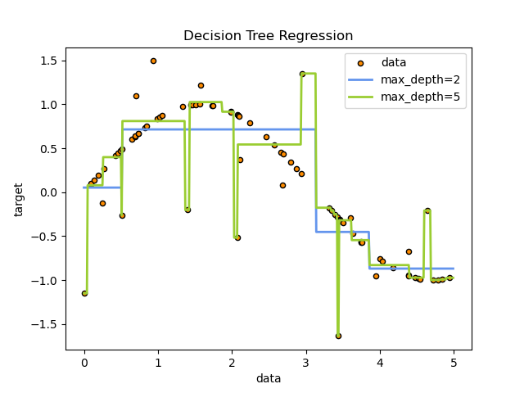
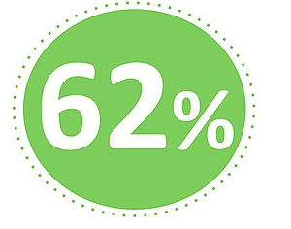
Model 2
Decision tree Regression
Not bad, can we do better than one tree?🤔

Slide 27
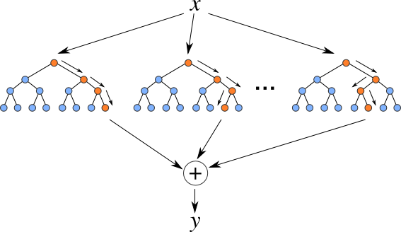
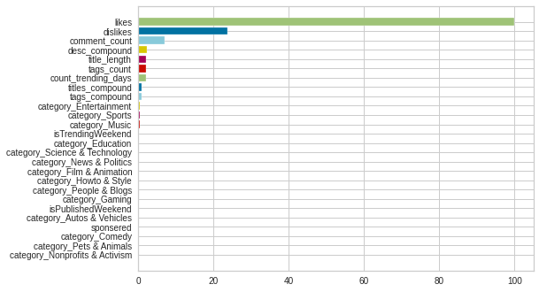
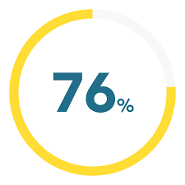
Model 3
Random forest regression
Now it is a whole forest not a lonely tree. We can get 76% accuracy. Likes play a MAJOR role in prediction

Slide 28
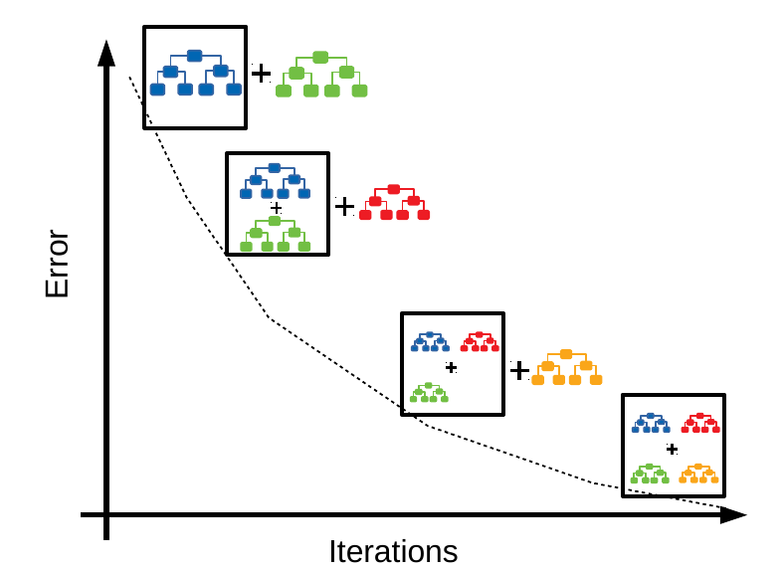
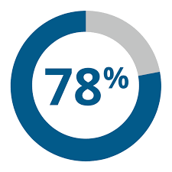
Model 4
Gradient Boost regression
Boosting vs Bagging
Now we can get almost 78% accuracy. Much Better!

Slide 29
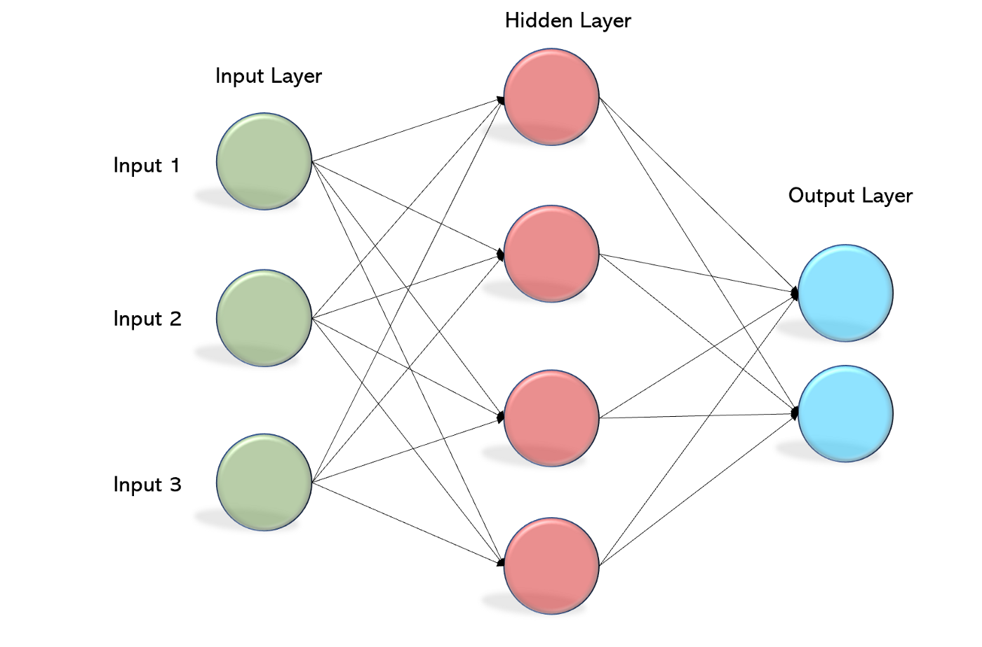
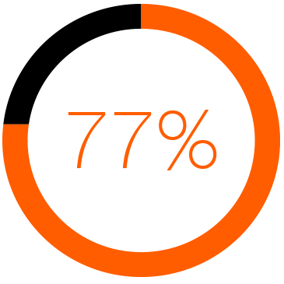
Model 5
Multi-layer perceptron (MLP)
Using Deep learning, we achieved around 77% accuracy.
But still boosting performs better!
Maybe Hyperparameters tuning can make a difference?

Slide 30
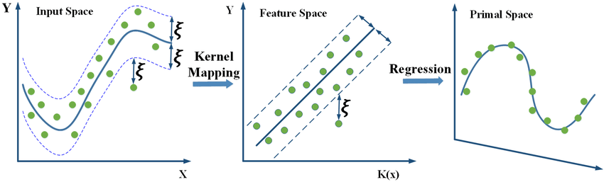

Model 6
Support vector regression (SVR)

Slide 31
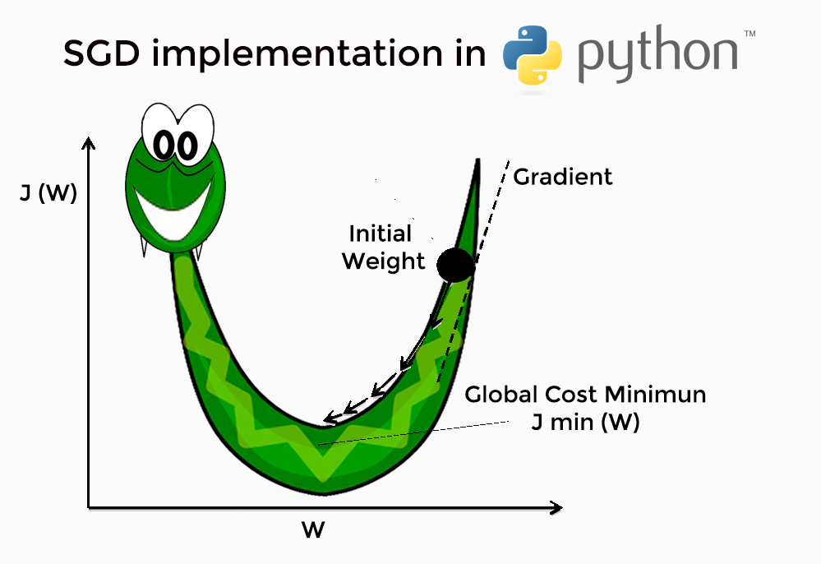
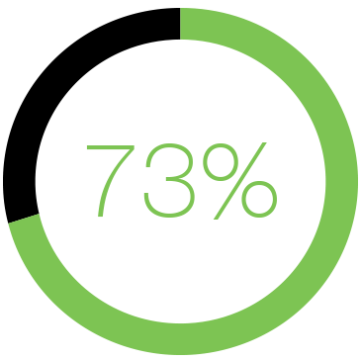
Model 7
SGD Regressor

Slide 32
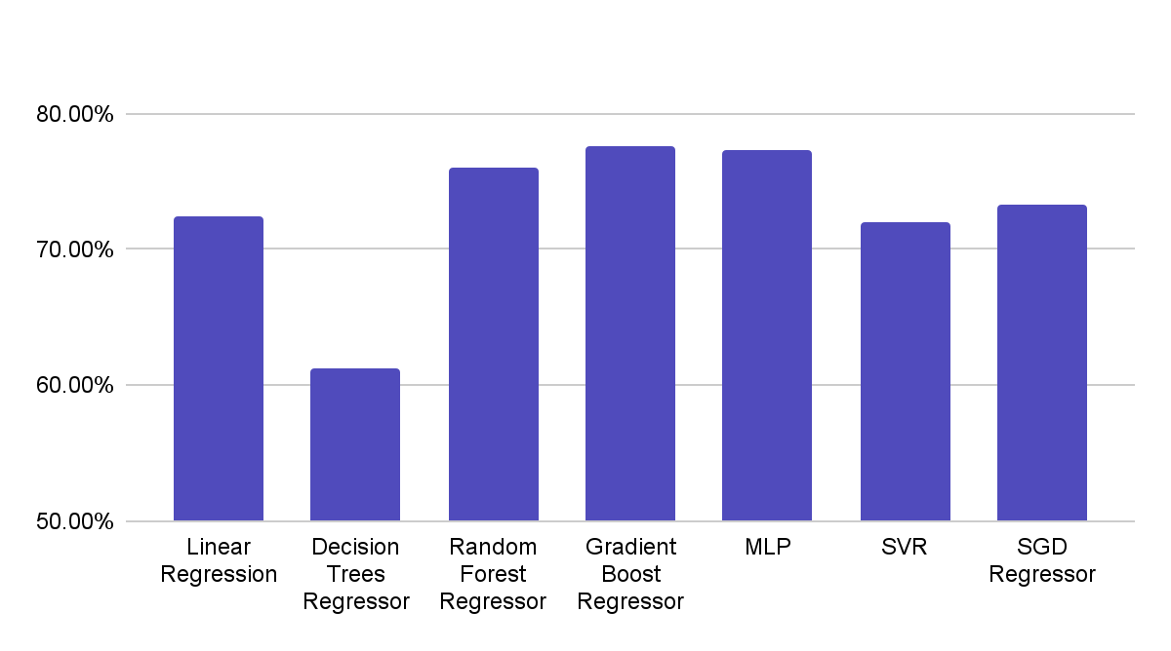
Models
Accuracy Comparison
Linear Regression | Decision Trees Regressor | Random Forest Regressor | Gradient Boost Regressor | MLP | SVR | SGD Regressor
72.45% | 61.27% | 76.07% | 77.55% | 77.36% | 72.06% | 73.25%

Slide 33
05
Data Driven Optimization

Slide 34
WHAT DO WE DO?
we recommend Ads companies to do the following in order to maximize their profits:
It is implicitly assumed that trendy videos are the ones that are used to display the ads on in order to maximize the profit. However, we are differentiating trendy videos from each other in order to maximize the profit.
Dynamically allocate their ads on videos that are predicted to have high number of views according to our model. elaborating more, it offers flexibility in ads allocation depending on making decisions in specific time spans.
Display their ads on the top 10 channels such as Mr. Beast, BlackPink, FFUNTV, SMTOWN, and Mr. Beast Gaming
Display their ads on videos with titles that has titles between 30-50 characters.
Display their ads on videos with well-written descriptions
Display their ads on videos between 4-5 pm because these times generate the highest views.
Sponsored videos do not perform better than non-sponsored videos in terms of ads. hence, budget can be allocated in a better manner.
Ads that are displayed on videos from Entertainment and Sports categories are predicted to score better in terms of views in 2020-2021.
display their ads on videos that have many tags since they are predicted to generate more views.
All days have equal probabilities of having trendy videos. However, videos that are published on Fridays are more probable to be trendy.

Slide 35

Thank you!

